Slide 1
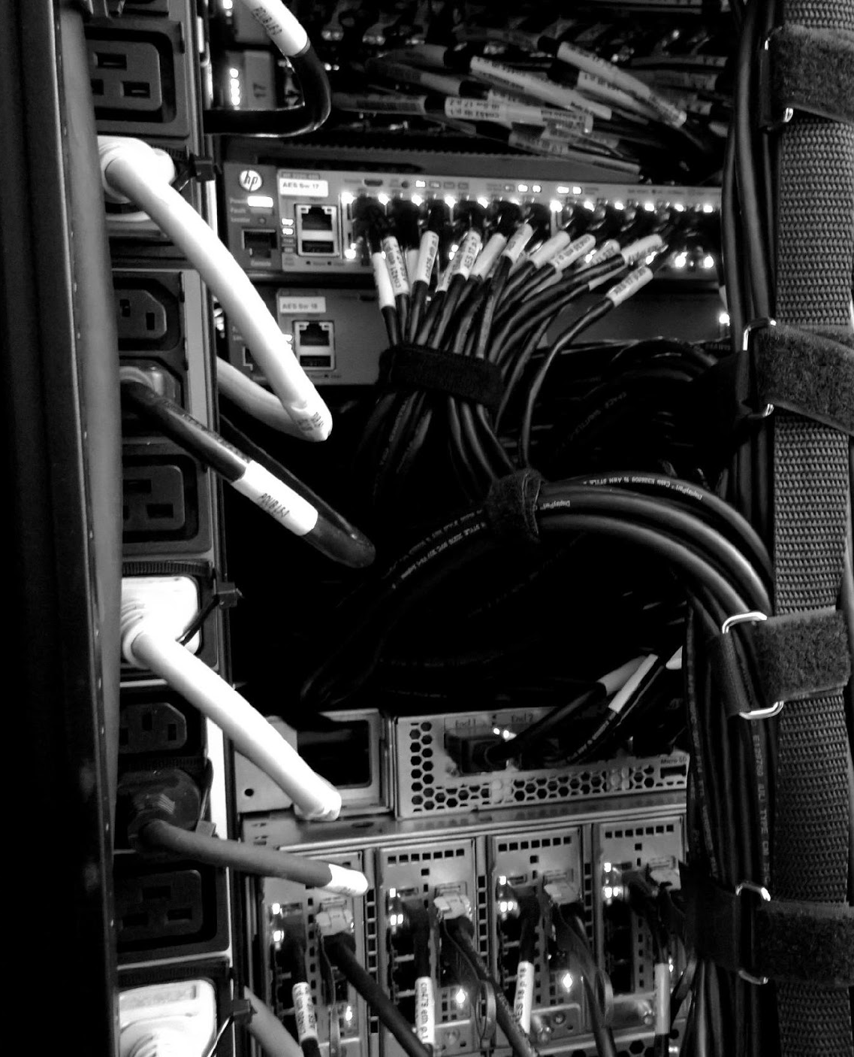

^{COMPUTEROME 2.0}
^{USERS WORKSHOP}
CENTER FOR HEALTH DATA SCIENCE (HEADS)
FACULTY OF HEALTH AND MEDICAL SCIENCES,
UNIVERSITY OF COPENHAGEN, FEBRUARY, 2021

Slide 2
^{PART 2}
^{THE BASI S}

Slide 3
BEFORE LOG IN TO COMPUTEROME 2.0
GETTING STARTED:
https://www.computerome.dk/display/C2W/Getting+Started+-+new+users#GettingStarted-newusers-SSHlogintoComputerome2.0
ACCOUNT
ENTRUST APP
PUTTY OR MOBAXTERM
(WINDOWS ONLY)
THINLINK CLIENT
Request a Computerome 2.0 account (group) in KU-IT self-service. Standard or Sandbox.
Two-factor authentication. Install the Entrust app on your phone or alternatively use the SMS option.
Windows users should have an ssh client. MobaXterm users have to configure their ssh settings - see link.
IF you would like a virtual environment, install the ThinLink Client - make sure to keep it updated.

Slide 4
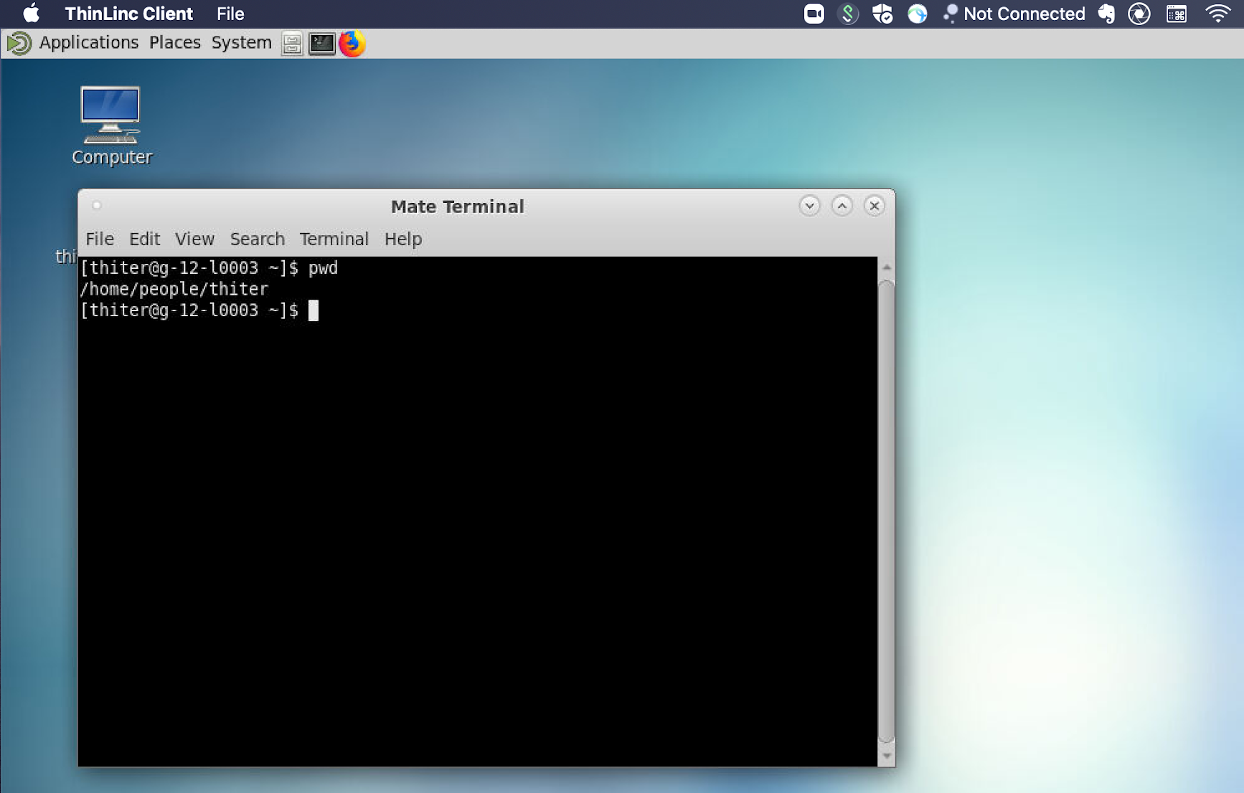
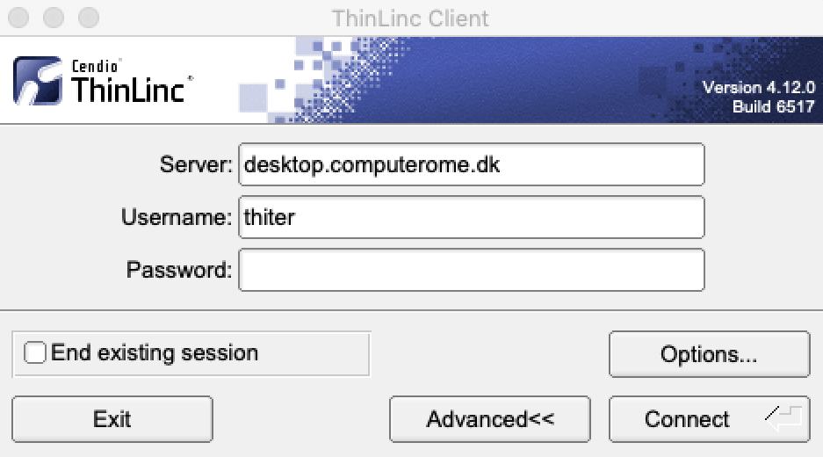
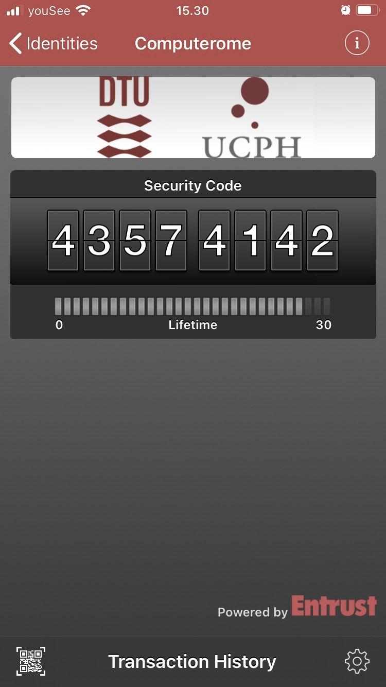
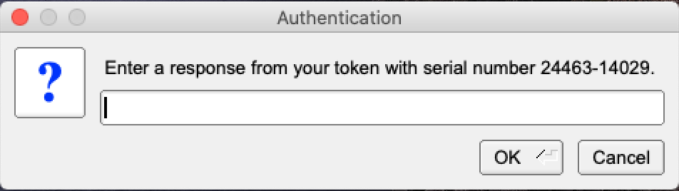
LOG IN TO COMPUTEROME 2.0
LOG IN WITH THINLINC
Download and install the ThinLinc Client
Open and enter your Username + Password
It make take a couple of minutes to connect
Enter the token from the Entrust App (or Confirm)
Open a terminal or click your way around
Exit a full screen - press the F8 key
LOG IN WITH SSH
>
Open a terminal
ssh username@ssh.computerome.dk
Enter your password
Enter the token from the Entrust App (or Confirm)

Slide 5
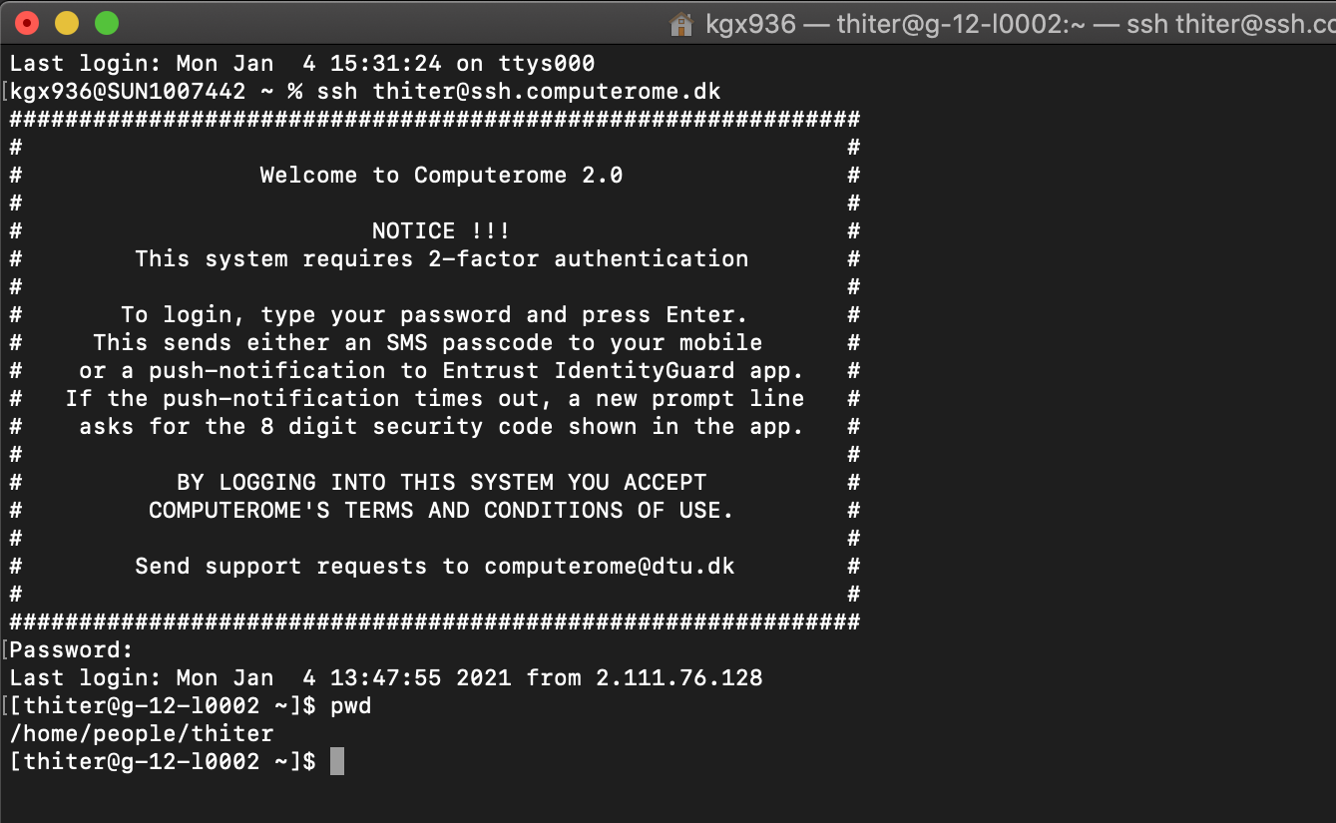
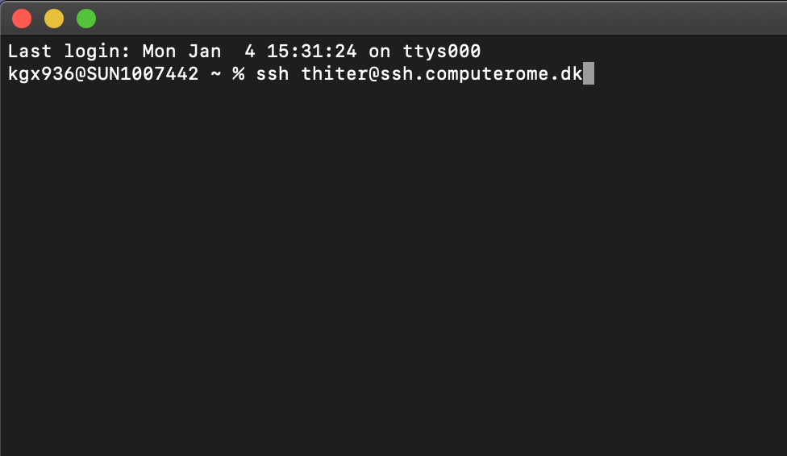
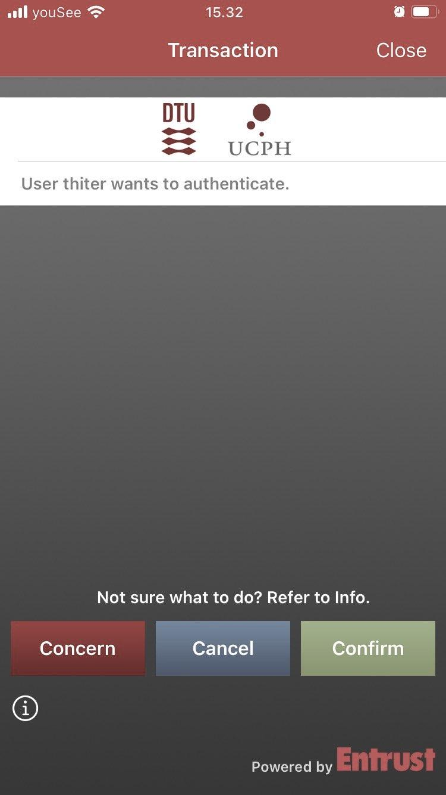
LOG IN TO COMPUTEROME 2.0 2.0
Download and install the ThinLinc Client
Open and enter your Username + Password
It make take a couple of minutes to connect
Enter the token from the Entrust App (or Confirm)
Open a terminal or click your way around
Exit a full screen - press the F8 key
LOG IN WITH SSH
>
Open a terminal
ssh username@ssh.computerome.dk
Enter your password
Enter the token from the Entrust App (or Confirm)

Slide 6
C2 SANDBOX STRUCTURE
HOME
DATABASES
PEOPLE
PROJECTS
DB X
DB Y
DB Z
(…)
(…)
PRO 1
PRO 2
PRO 3
(…)
(…)
(…)
(…)
LOG IN
(…)
APPS
DATA
PEOPLE
WORK HERE

Slide 7
C2 SANDBOX STRUCTURE
1
/home/people/username
2
/home/databases
HOME
HOME
Your private directory.
This space is meant for configuration files.
Do NOT store data here (max 10G)
Do NOT run jobs from here.
Shared database resource
Databases include:
PEOPLE
DATABASES
Human genomes
Blast
TCGA / GTEx
dbSNP
ClinVar / COSMIC
…
DB X
DB Y
DB Z
(…)
(…)
(…)
LOG IN

Slide 8
C2 SANDBOX STRUCTURE
3
/home/projects/project
HOME
Your project directory.
./apps : project specific applications & modulefiles
./archive: dataproject specific data
./scratch: temporary & re-creatable data N.B will not be backed up!
./review used for peer-review.
PROJECTS
PRO NAME
YOUR PROJECT
APPS
ARCHIVE
DATA
PEOPLE
REVIEW
SCRATCH
MODULEFILES
RAW
GENERATED
WORK HERE
APPS

Slide 9
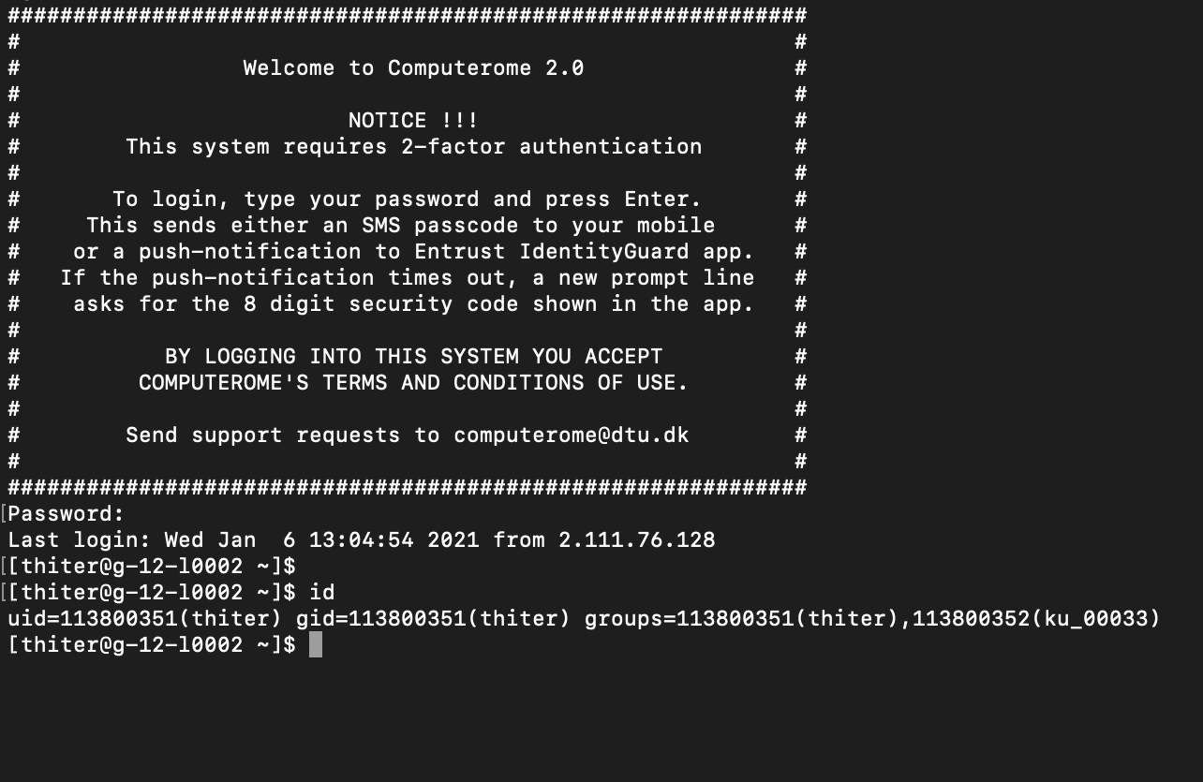
YOUR PROJECT AND GROUP
PROJECT
PROJECT NAME
Type in <id> to get this information
<project> usually refers to the projects funding.
<project_name> is the name given by the C2 team. Almost exclusively the same as <project>.
USERNAME
<username>
Your unique user ID. Can be connected to multiple projects and groups.
GROUP NAME
UNIX
<group_name>
ID assigned by DTU. Refers to the UNIX group, e.g. the projects/users access to resources.
Often the same as <project_name>.

Slide 10
GOOD TO KNOW
COMPUTEROME 2.0 WIKI - FIND EVERYTHING HERE
https://www.computerome.dk/
VIDEO TUTORIALS - HELPFUL TO WINDOWS USERS
https://www.computerome.dk/display/C2W/Video+Tutorials
BRUSH UP ON YOUR UNIX SKILLS
https://www.computerome.dk/display/C2W/Getting+Started+-+new+users?preview=/42205237/42205239/Hackinars_in_Computerome-wiki.pdf
CHECK YOUR USAGE ON C2
CHECK YOUR USAGE ON C2
module load tools usage_script/2.0
usage -u username
GETTING HELP
Write to computerome@dtu.dk
Subject description
System, e.g. Computerome main, sandbox, or <named> cloud system
Login issues, ThinLinc vs SSH login, username & error message(s)
Command line(s) used
Describe the problem including error messages

